Slide 1
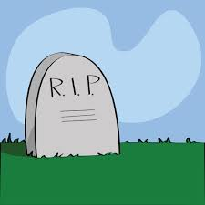
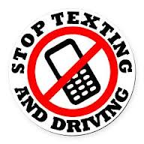
Daeja Lyles
Texting and Driving

Slide 2
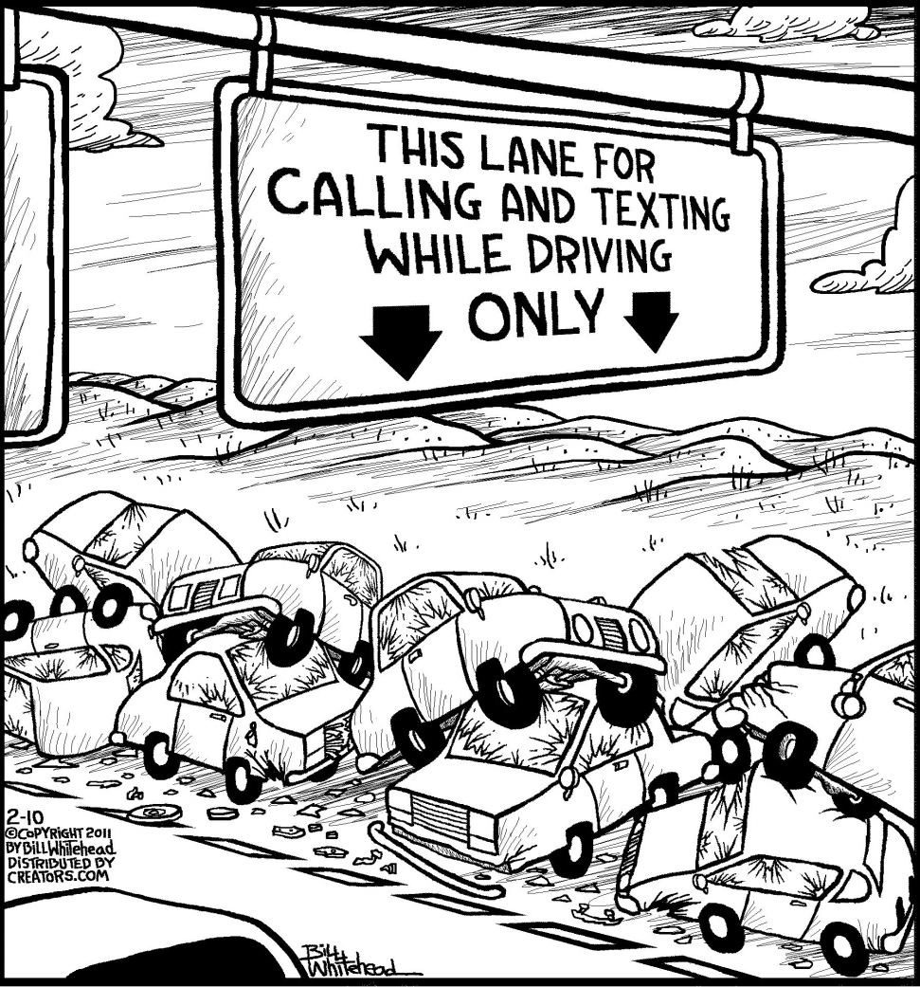
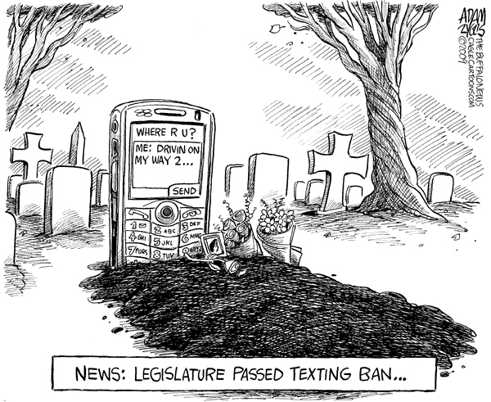

Slide 3
Why We Love Texting
Quick and easy way to communicate
Not likely for private messaging to be overheard by someone else
Easier for people with disabilities such as being deaf to communicate
Text messaging encourages briefer, more efficient exchanges of information

Slide 4
Dangers of Texting while driving
Killing or harming yourself or someone else
Spending time in jail or having other punishments
Destroying someone’s property

Slide 5
Cell Phone and Texting Law
State of Georgia Cell Phone and Texting Law:
Hand-Held Ban - NO
Young Drivers all Cellphone Ban - Drivers younger than 18
Bus Drivers all Cellphone Ban – School Bus Drivers
Texting Ban - ALL DRIVERS
Enforcement - Primary

Slide 6
Article
Family of fatal crash victim: ‘Never, never text and drive’
This article is about a family that recently lost their son from a texting and driving accident. “I can’t bear he thought of anyone else having to go through something like this! Please vow to never, NEVER text and drive. In a split second you could ruin your future, injure or kill others, and tear a hole in the heart of everyone who loves you,” Sharon Heit (his mother) said. He dies after his car ran off the road April 3 . The police determined that he lost control because he was texting and driving.

Slide 7
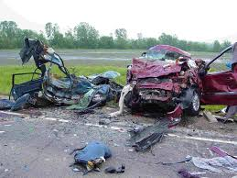
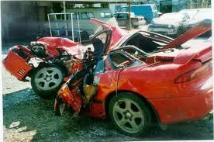
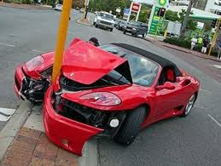
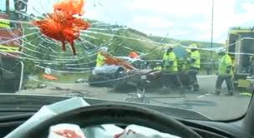
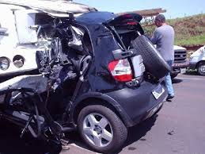
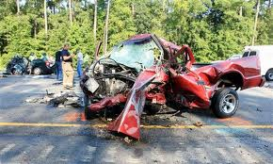
This Could Happen To you

Slide 8
Alternative 1
Download an App That can help you stop driving and texting. A few very popular apps that individuals download to prevent texting and driving is Textecution, tXtBlocker, AT&T DriveMode, Drive Safe.ly, and DriveScribe! Download these apps for a low price or Free to keep yours and another’s life safe.

Slide 9
Alternative 2
Out of Sight, Out of Mind! Keep your cellphone in a place where you know you will not have easy access to it. When your keep your phone in a place that you can’t easily get to, it will make you make not as tempted to keep checking your phone.

Slide 10
Alternative 3
Silence your phone! When your phone is on silent, you will not have any distractions therefore you won’t feel the need to keep checking your phone for new notifications. The less you hear your phone, the less tempted you would be to respond while driving.

Slide 11
References
http://www.iihs.org/laws/cellphonelaws.aspx#GA
http://www.stoptextsstopwrecks.org/#home
http://www.mynationwidemagazine.com/3-apps-stop-texting-while-driving
http://mashable.com/2012/12/17/texting-driving-apps/
http://drivesteady.com/6-alternatives-to-texting-while-driving

